Slide 1
NEO Persistable Classes 1.0 An Efficient Object-Oriented Framework for C#.NEO Smart Contract Development
NEO Community Bluepaper
Michael Herman
https://github.com/mwherman2000/neo-persistibleclasses
neotoronto@outlook.com

Slide 2
Agenda
Purpose
Scenario
Problem
Analysis
Options
Code Solution
Test Results
Future Work
Summary
Appendix A - NEO Blockchain Architecture Reference Model (ARM)

Slide 3
1. Purpose

Slide 4
2. Scenario

Slide 5
3. Problem
public class Point /* Level 0 */
{
private BigInteger _x;
private BigInteger _y;
// Factory methods
private Point()
{
}
}

Slide 6
4. Analysis

Slide 7
5. Options

Slide 8
6. Solution
NPC Level 0 Fields Only
NPC Level 1 Managed
NPC Level 2 Persistable
NPC Level 3 Deletable (Bury/Tombstone)
NPC Level 4 Collectible
NPC Level 5 Extendible (future work)
NPC Level 6 Authorized (future work)

Slide 9
NPC Level 0 Fields Only - Point
public class Point /* Level 0 */
{
private BigInteger _x;
private BigInteger _y;
// Factory methods
private Point()
{
}
}

Slide 10
NPC Level 1 Managed – NeoTrace
public class NeoTrace /* Level *all* */
{
public static void Trace(params object[] args)
{
Neo.SmartContract.Framework.Services.Neo.Runtime.Notify(args);
}
}

Slide 11
NPC Level 1 Managed – NeoEntityModel
public static class NeoEntityModel /* Level 1 */
{
public enum EntityState
{
NULL, INIT, SET
}
public static BigInteger AsBigInteger(this EntityState state)
{
int istate = (int)state;
BigInteger bis = istate;
return bis;
}
public static EntityState BytesToEntityState(byte[] bsta)
{
int ista = (int)bsta.AsBigInteger();
NeoEntityModel.EntityState sta = (NeoEntityModel.EntityState)ista;
return sta;
}
}

Slide 12
NPC Level 1 Managed – Point
public class Point : NeoTrace /* Level 1 */
{
private BigInteger _x;
private BigInteger _y;
private NeoEntityModel.EntityState _state;
// Accessors
public static void SetX(Point p, BigInteger value)
{ p._x = value; p._state = NeoEntityModel.EntityState.SET; }
public static BigInteger GetX(Point p) { return p._x; }
public static void SetY(Point p, BigInteger value)
{ p._y = value; p._state = NeoEntityModel.EntityState.SET; }
public static BigInteger GetY(Point p) { return p._y; }
public static void Set(Point p, BigInteger xvalue, BigInteger yvalue)
{ p._x = xvalue; p._y = yvalue; p._state = NeoEntityModel.EntityState.SET; }

Slide 13
NPC Level 1 Managed – Point (con’t)
// Factory methods
private Point()
{
}
private static Point _Initialize(Point p)
{
p._x = 0;
p._y = 0;
p._state = NeoEntityModel.EntityState.NULL; ;
LogExt("_Initialize(p).p", p);
return p;
}
public static Point New()
{
Point p = new Point();
_Initialize(p);
LogExt("New().p", p);
return p;
}

Slide 14
NPC Level 1 Managed – Point (con’t)
public static Point New(int x, int y)
{
Point p = new Point();
p._x = x;
p._y = y;
p._state = NeoEntityModel.EntityState.INIT;
LogExt("New(x,y).p", p);
return p;
}
public static Point Null()
{
Point p = new Point();
_Initialize(p);
LogExt("Null().p", p);
return p;
}

Slide 15
NPC Level 1 Managed – Point (con’t)
// EntityState wrapper methods
public static bool IsNull(Point p)
{
return (p._state == NeoEntityModel.EntityState.NULL);
}
// Log/trace methods
public static void Log(string label, Point p)
{
NeoTrace.Trace(label, p._x, p._y);
}
public static void LogExt(string label, Point p)
{
NeoTrace.Trace(label, p._x, p._y, p._state);
}
}

Slide 16
NPC Level 2 Persistable - TODO

Slide 17
NPC Level 3 Deletable - TODO

Slide 18
NPC Level 4 Collectible - TODO

Slide 19
7. Test Results
Test1()
Dump miscellaneous variables to the log
Test2()
NPC Level 1 test cases: Create 3 Points and a line. Add two Points. Log the results.
Test3()
NPC Level 2/3 test cases: Create 3 Points and test NPC Level 3 entity persistence. Log the results.
Test4()
NPC Level 2/3 test cases: Test IsNull(), IsMissing() and IsExtended(). Log the results.
Test5()
NPC Level 4 test cases: Test NeoStorageKeys. Log the results.
Test6()
NPC Level 4 test cases: Test NeoStorageKeys. Log the results

Slide 20
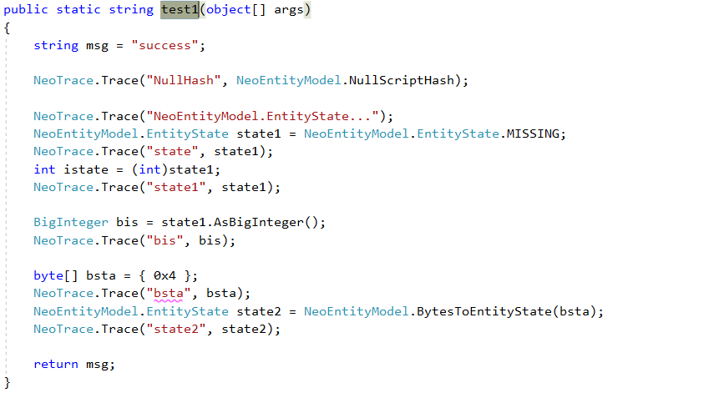
Test1() – Code

Slide 21
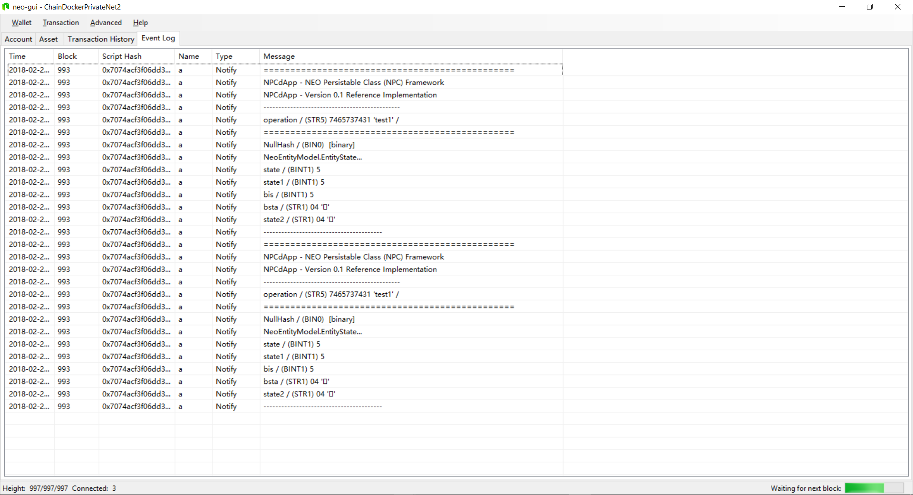
Test1() – neo-gui Event Log

Slide 22
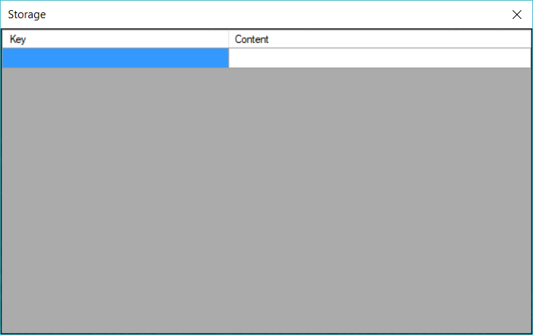
Test1() – neo-debugger Storage Viewer

Slide 23
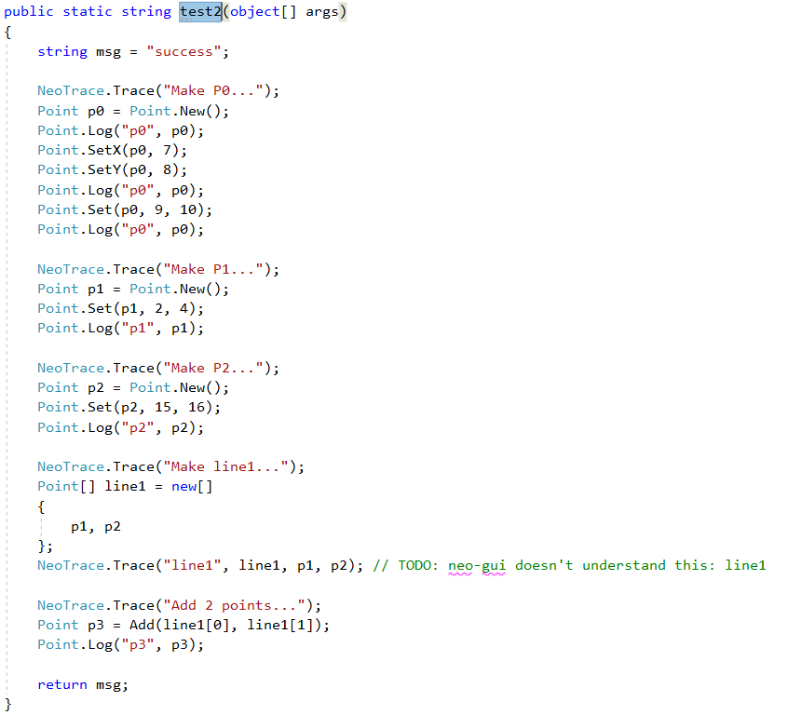
Test2() – Code

Slide 24
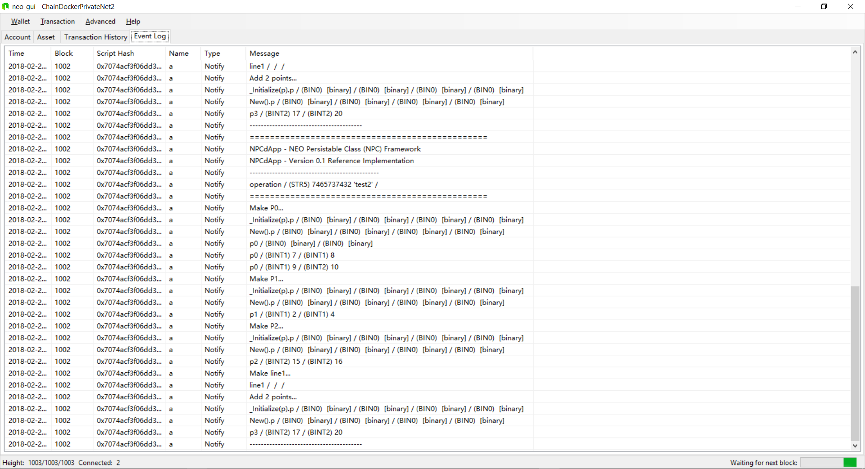
Test2() – neo-gui Event Log

Slide 25
Test2() – neo-debugger Storage Viewer

Slide 26
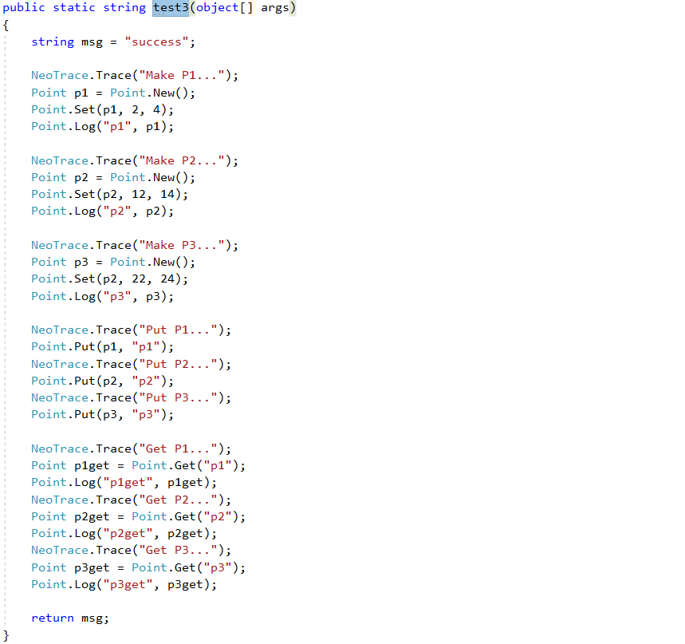
Test3() – Code

Slide 27
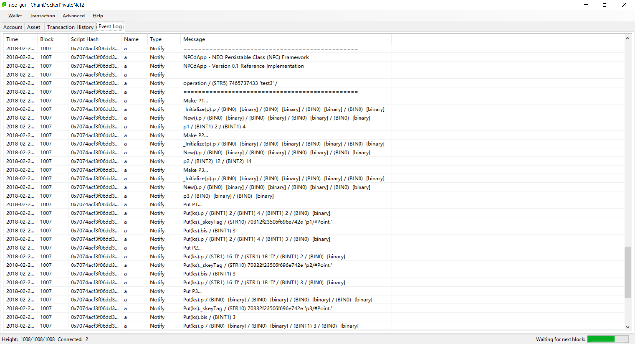
Test3() – neo-gui Event Log

Slide 28
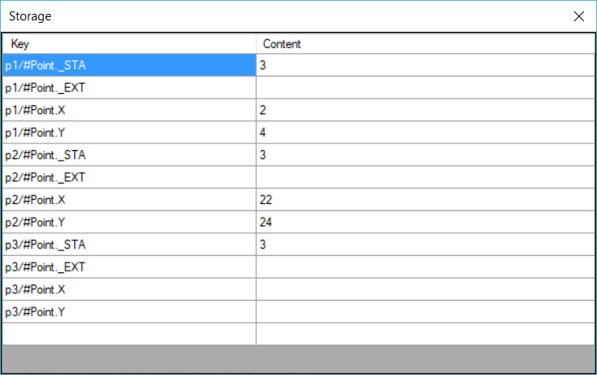
Test3() – neo-debugger Storage Viewer

Slide 29
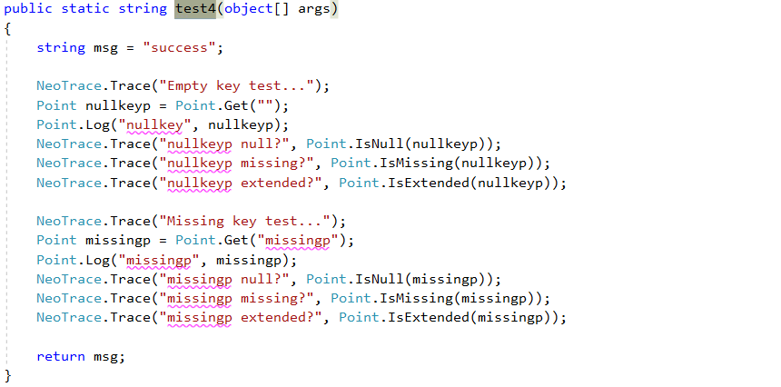
Test4() – Code

Slide 30
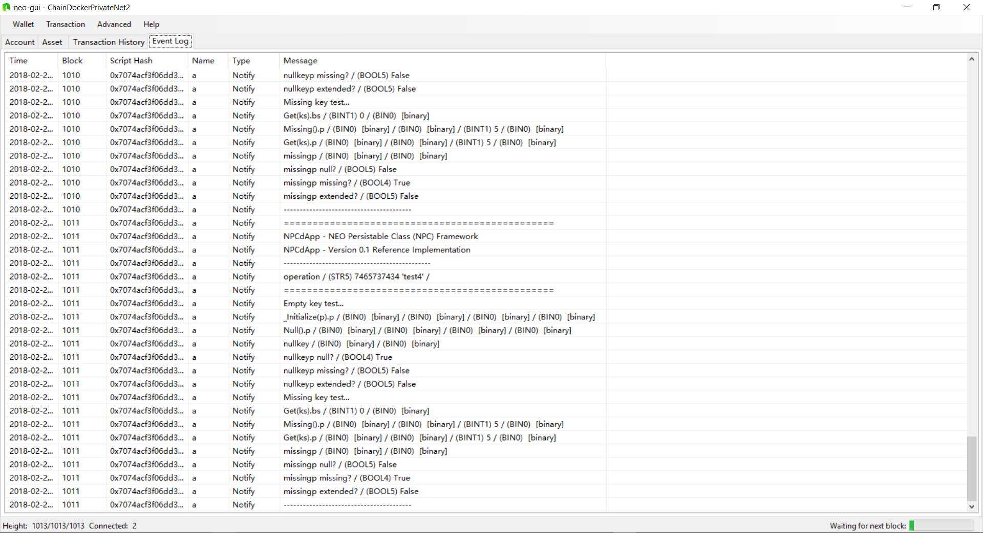
Test4() – neo-gui Event Log

Slide 31
Test4() – neo-debugger Storage Viewer

Slide 32
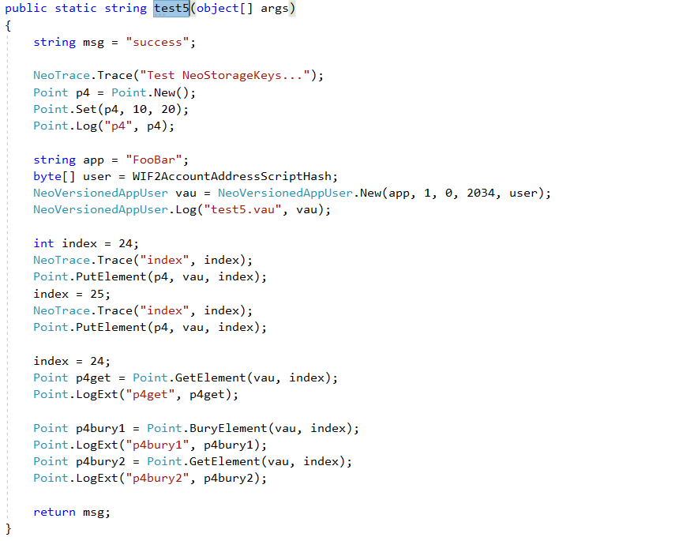
Test5() – Code

Slide 33
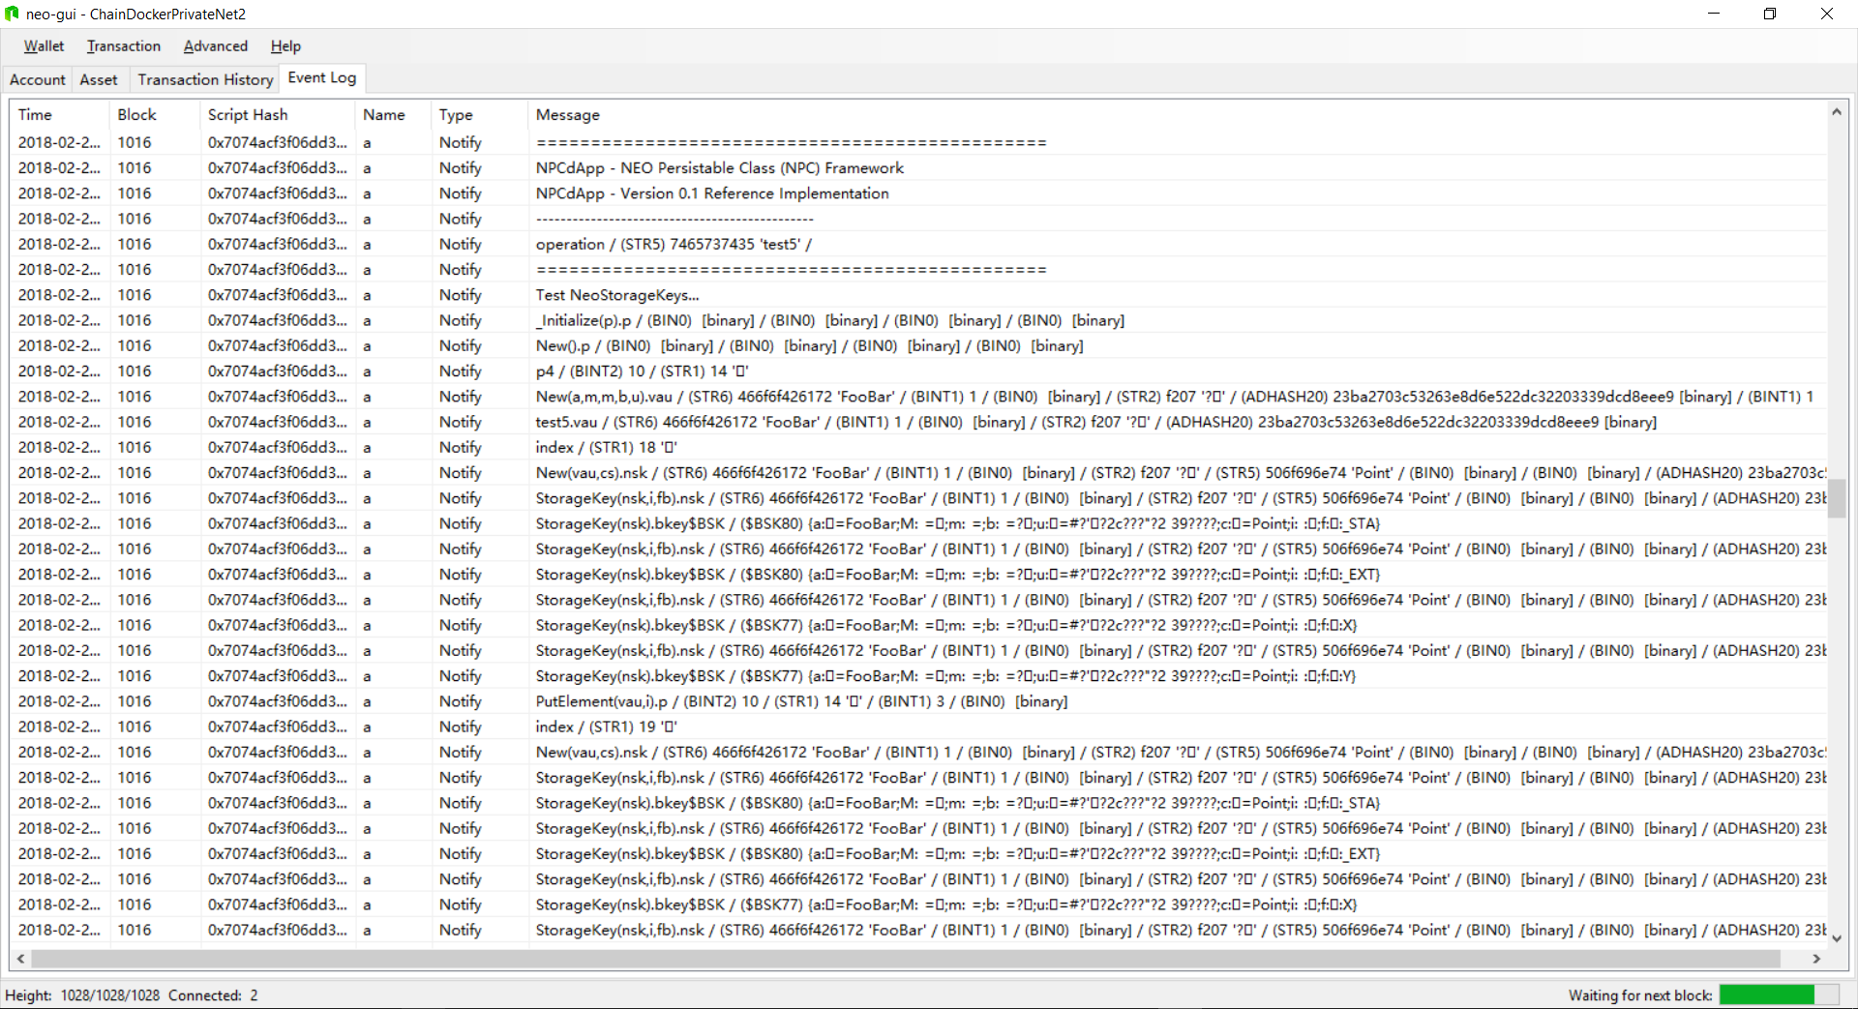
Test5() – neo-gui Event Log

Slide 34
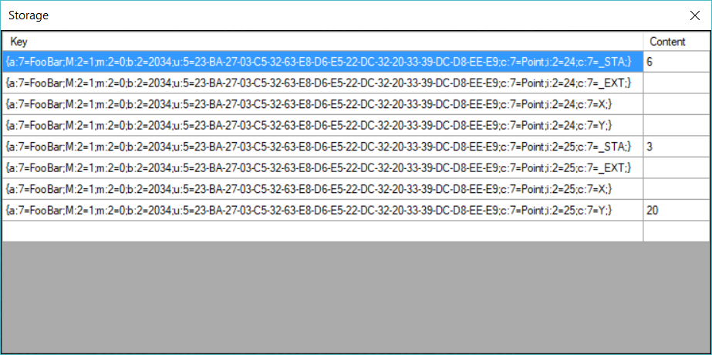
Test5() – neo-debugger Storage Viewer

Slide 35
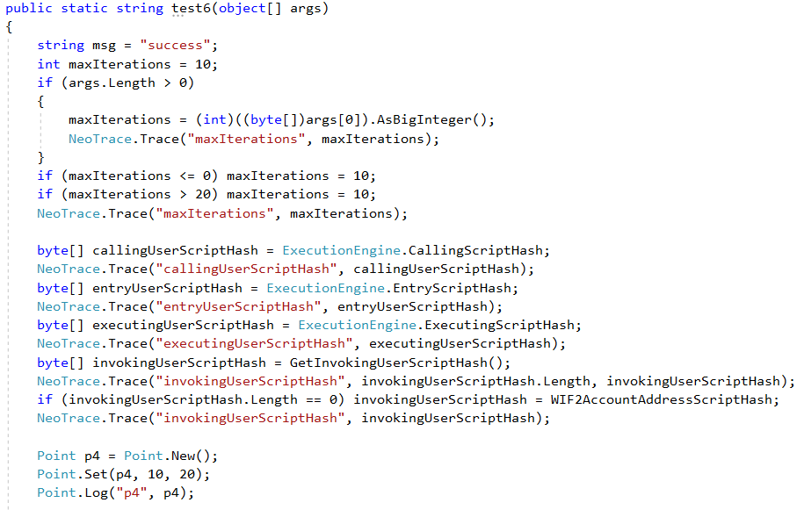
Test6() – Code

Slide 36
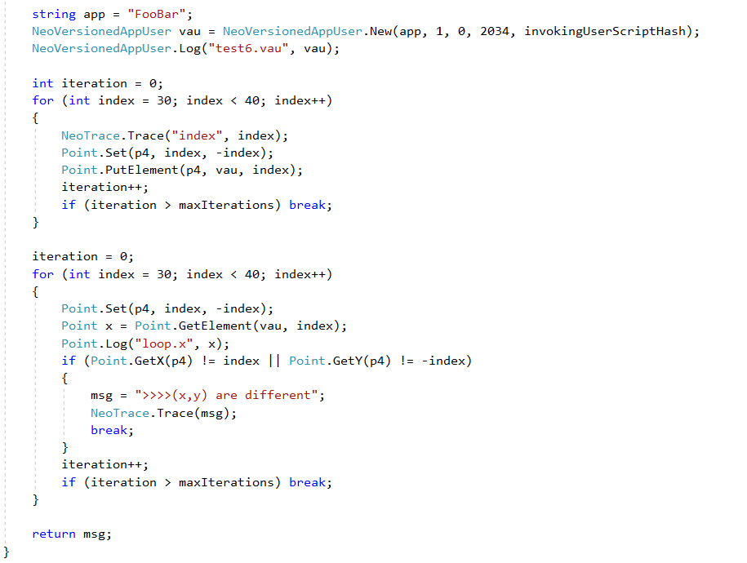
Test6() – Code (con’t)

Slide 37
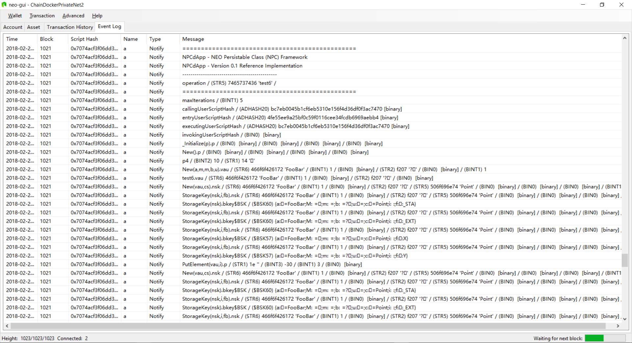
Test6() – neo-gui Event Log

Slide 38
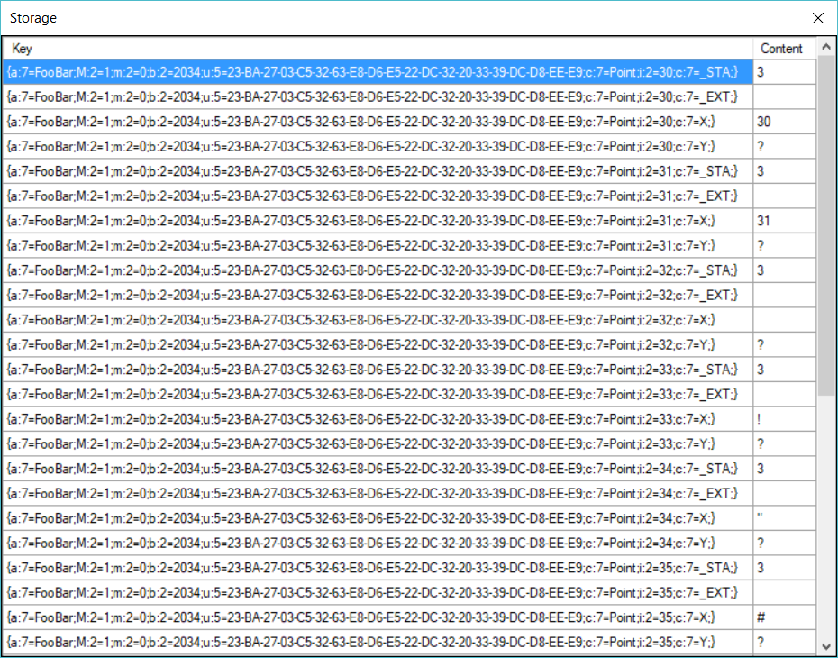
Test6() Results – neo-debugger Storage Viewer

Slide 39
8. Future Work

Slide 40
9. Summary

Slide 41
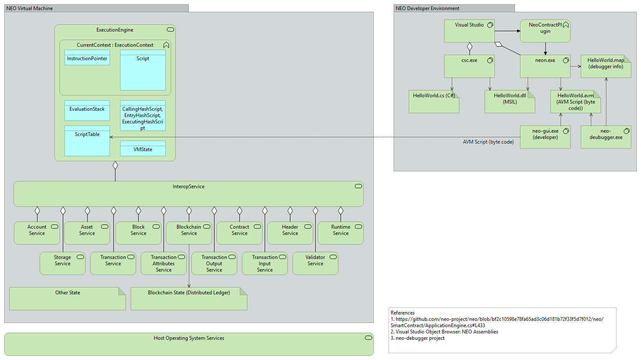
A - NEO Blockchain Architecture Reference Model (ARM)

Slide 42
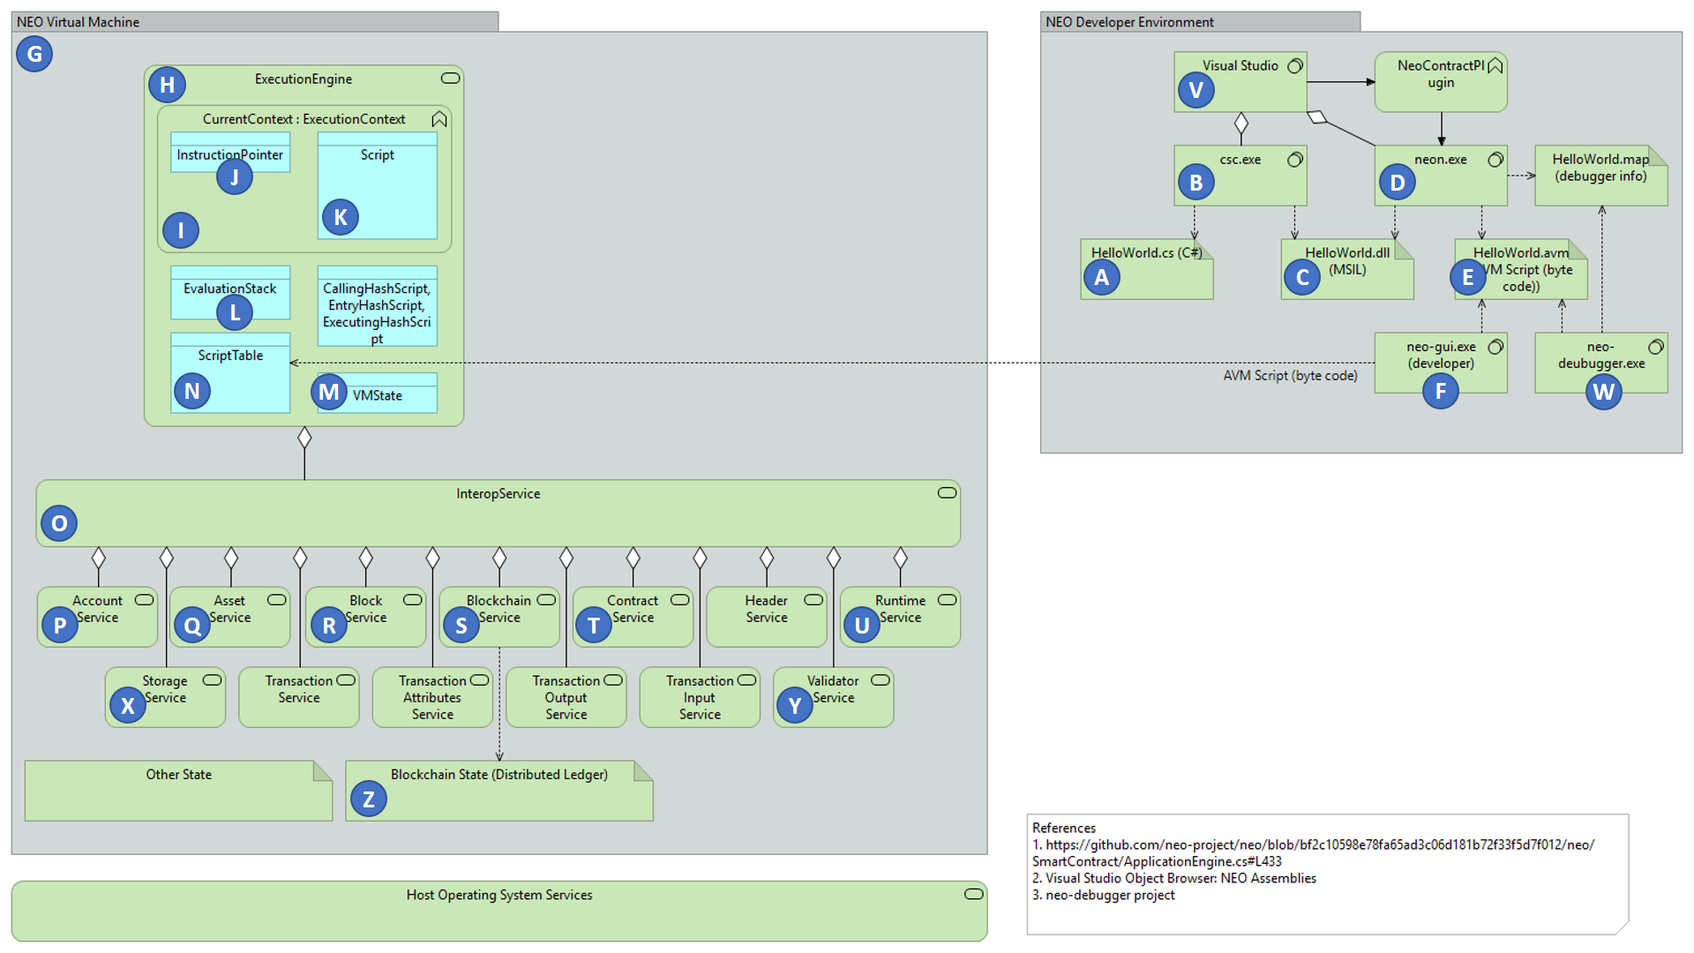
NEO Blockchain ARM

Slide 43
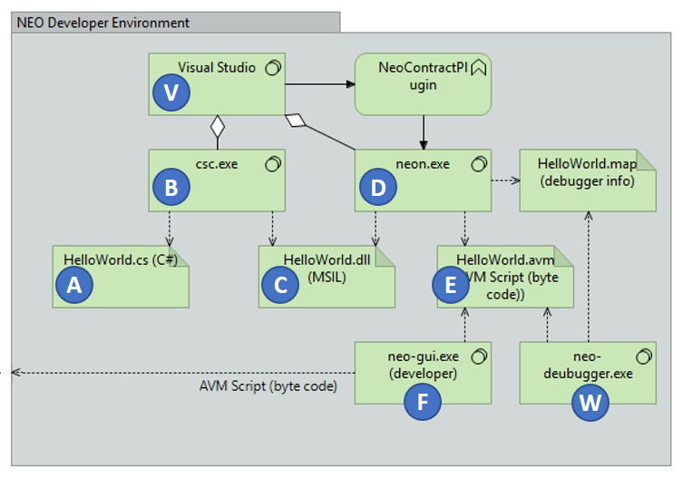
NEO Developer Environment

Slide 44
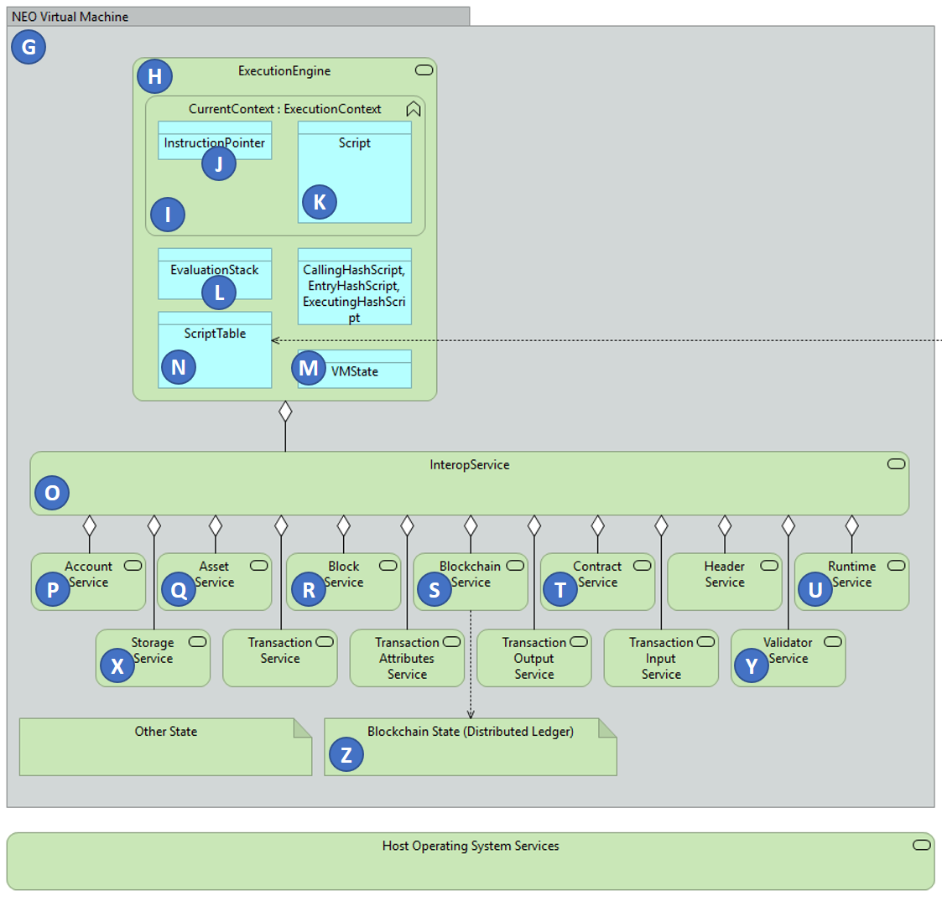
NEO Virtual Machine

Slide 45
Questions?
neotoronto@outlook.com

